Slide 1
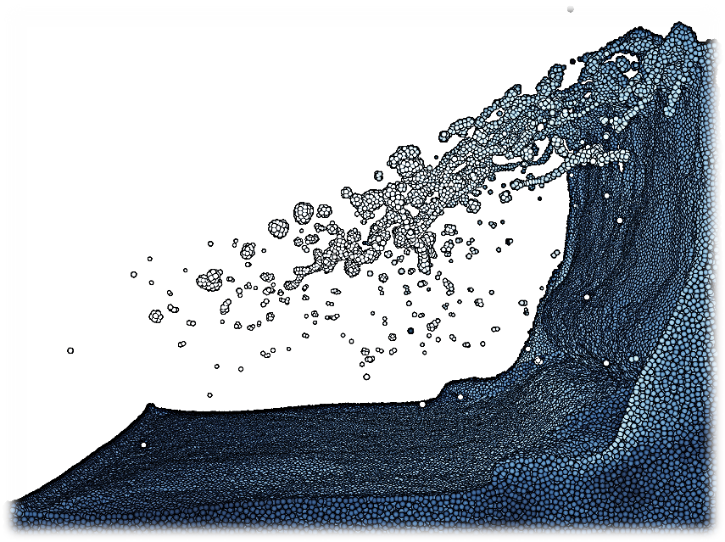
Haptic Particle Simulations
M.Tech 1st Stage Project
Dwaipayan Sardar * | 143079009
GUIDE: Prof. Subhasis Chaudhuri *
EXAMINAR: Prof. Abhishek Gupta #
* - Department of ElectricalEngineering, IIT Bombay
# - Department of Mechanical Engineering, IIT Bombay
VIP Lab
EE, IIT Bombay
R. Winchenbach and et al, “Constrained Neighbor Lists for SPH-based Fluid Simulations“, ACM SIGGRAPH 2016

Slide 2
Motivation
It’s need:
Natural alike interactive simulation
Particle dynamics is favorable in modelling a wide variety of objects [Macklin ‘14]
Adds an edge in fluid and deformable object rendering
Above materials finds use in tissue & bio-fluid modelling and VR games
How it is achieved?
DEM and SPH techniques for particle physics modelling
Considering independent particles: leveraging extensively parallel GPU architecture
High DoF Haptics point devices and open source C++ libraries fro interfacing them

Slide 3
Particle simulations: overview
Obejective: Simulation of fluids composed of particles
Methods:
This Discrete Element Modelling – Lagrangian based
Few assumptions:
A set of particles enclosed in a hollow volume
Collide inelastically with immediate neighbors: particles, colliders and bounding walls
No gravitational attraction is considered among the particles, though a constant global gravity affects the overall system
Eulerian | Lagrangian
Workspace is discretised into grid | Material is discretised into particles
Compute properties at all grid points | Perform computation wherever necessary

Slide 4
Particle simulations: physical modelling
Discrete Element Method or DEM
V_{AB}^{Tan}
V_{B}
V_{AB}
V_{A}
V_{AB}^{Nor}
B, R_{B}
F_{a}
|P_{AB}|
F_{P}
A, R_{A}
P_{AB}
F_{sh}
P_{A}
P_{B}
O

Slide 5
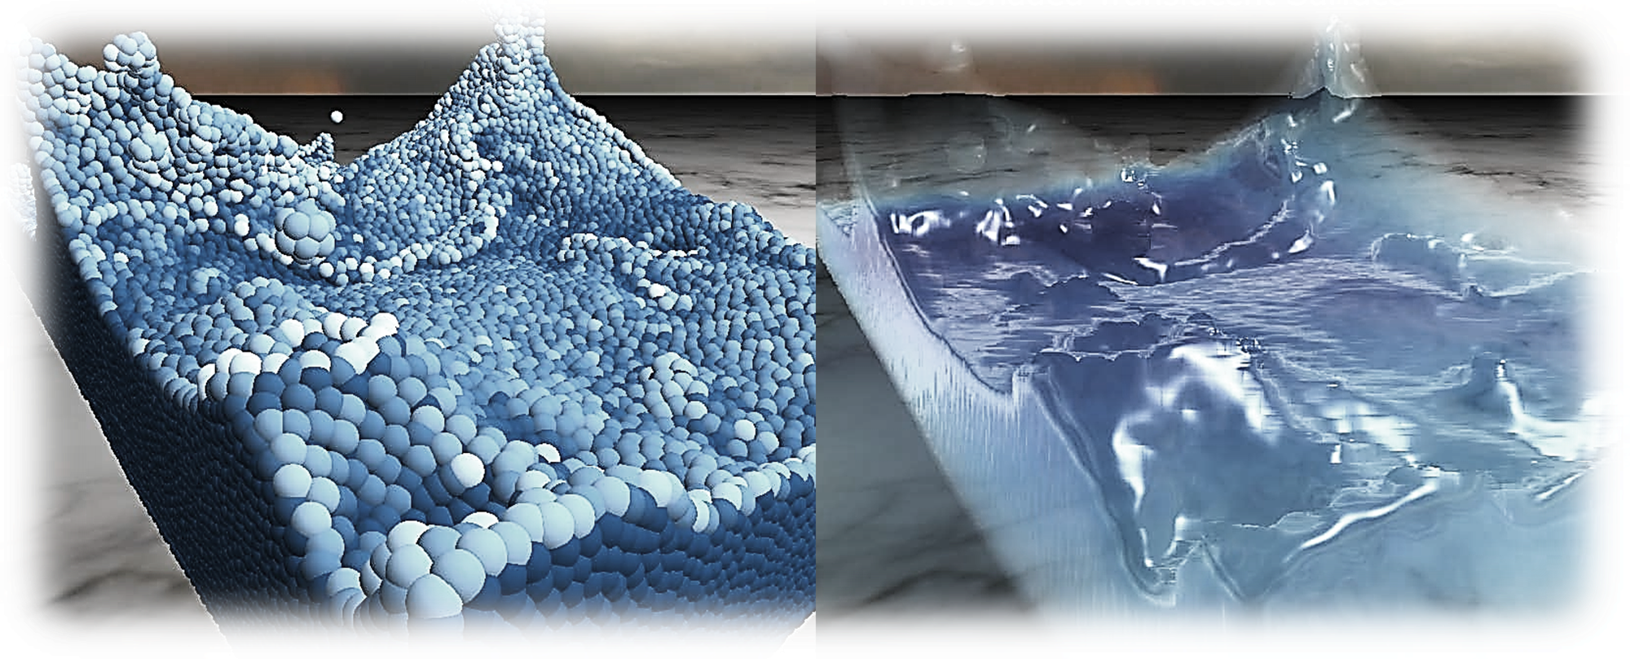
Fluid seen as particles
Simulated forces:
Forming small deformable clusters of particles
Constructing isosurfaces of clusters:
Challenges in real time:
Pressure | Viscosity | Surface tension | Interactions
Marching Cubes | Point Splats
Large no. of particles | Numerous terms in Navier Stokes Eq.
Interactive speed | Handled by independent threads
https://developer.nvidia.com/content/fluid-simulation-alice-madness-returns

Slide 6
SPH: Navier-Stokes equations
Navier-stokes equations (NSE) for in-compressible flow:
SPH approximates NSE on a set of particles: providing fluid appearance [Muller ‘03]
For an instant of time the spatial derivative only affects kernel (spatially varying)

Slide 7
SPH: introduction
Introduced in ’70s to simulate astronomical fissions and collisions [Lucy, Gingold]
People utilized it to simulate flow: fluidic, granular or even deformable objects
Quantities derived from neighbors by interpolating
Density formulation:
Smoothed quantity:
Kernels are smoothening functions:
Various forces are smoothed according to complexity of fluid, or granularity, and added to NSE

Slide 8
SPH: forces in N-S equations
Pressure:
Viscous force:
Surface tension:
Where:
Adhesion:

Slide 9
User interactions
Challenges in real time:
Visual interface ~ 30 – 60 fps {mouse keyboard}
Haptic interface ~ 500 – 1000 KHz {Novint Falcon(3DoF)}
f term in NSE takes care of this force
Haptics incorporation into simulation:
Hardware update rate kept constant at 1000KHz
Still, force update rate is limited by SPH rendering lag
Can be reduced by independent calulations in CUDA
M.Tech 1st Stage Electrical Engineering, IIT Bombay

Slide 10
Implementation – Initialisations and approximations
Particle attributes: Position, Velocity
Proxy attributes: Position, Force
Initialisations:
Particle attributes
Proxy position
Constant gravity
Approximations:
No friction (or shear) in boundary walls
Haptic thread update ~ (1KHz), but new force update (~50Hz)
Each iteration compute:
Force on each particle independently {based on prev attributes}
Sort and update position of each {integration and grid update}
M.Tech 1st Stage Electrical Engineering, IIT Bombay

Slide 11
Implementation – steps
Collision Processing { accumulate force from neighbors, collider, walls }
Pressure (damped spring)
Shear (viscosity)
Integration { position ← velocity ← force }
Change in velocity ← accumulated force
Position ← simulation time step * velocity
Grid update { position and velocity are sorted according to grid index }
Fast radix sorting and update to new
Improve memory access coherence
Attraction (after collision)
If proxy collision detected: non-zero collider forces sent to host for accumulation

Slide 12

Implementation – source of forces I
Pressure, collide attraction {adhesion} and shear {viscosity} from other particles
DEM :
Forces interpolated from box kernel :
Max 26 immediate neighbors of each :
Influence: Iff nbd ≠ empty :
Nbd forces accumulated :
SPH with forces* from nbd with box kernel ↔ DEM
P_{i}
* Forces integrated to attributes, interpolated to fixed grid position. Forces composed of pressure, viscosity and adhesion

Slide 13
Implementation – source of forces II
Pressure, collide attraction {adhesion} and shear {viscosity} from collider
Pressure from boundary walls | Collider force
Damped spring force | Pressure, attraction and shearing
Wall
F_{P}
Ci
P_{i}
P_{i}

Slide 14
Implementation – CUDA
Particle attributes {graphical rendering} : sorted position and velocity
Collider attribute {haptic rendering} : force from particle collision
Independent CUDA threads computed at one time instant
Particles : accumulated forces integrate to attributes
Collider : accumulated forces sent to haptic rendering
Particle attribute calculation : occupy one CUDA thread per particle
Collider force accumulation : occupy one CPU thread
Grid interpolation & sorting : occupy one CUDA thread per particle

Slide 15
Implementation – steps
Collision Processing { accumulate force from neighbors, collider, walls }
Pressure (damped spring)
Shear (viscosity, friction)
Integration { position ← velocity ← force }
Change in velocity ← accumulated force
Position ← simulation time step * velocity
Grid update { position and velocity are sorted according to grid index }
Fast radix sorting and update to new
Improve memory access coherence
Attraction (after collision)
If proxy collision detected: non-zero collider forces sent to host for accumulation

Slide 16
Implementation: graphical rendering
Particle attribute calculation
Grid interpolation and sorting without transferring to host
Storing attributes in device memory, to send directly for graphical rendering
Positions allocated as float4arrays, in OpenGL vertex array object (VBO)
VBO is mapped for use by CUDA GL for rendering @ 20-100 fps

Slide 17
Implementation: haptic rendering
A haptic force field is constructed from collider force
Force field is buffered and fed to a Novint Falcon haptic device
Collider attribute calculation in a cpu thread

Slide 18
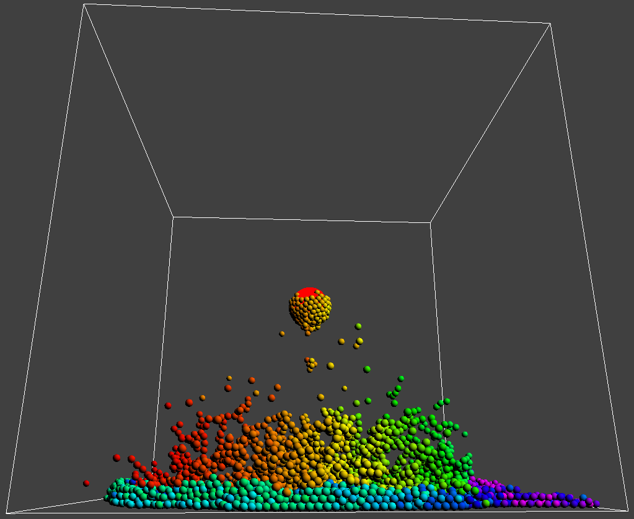
Implementation: Results – I
10,000 particles ~ 48fps
A ball of particles dropped on collider (proxy)
Particle clusters on bouncing
Some particle cling to collider (sticky)
User gets haptic feedback

Slide 19
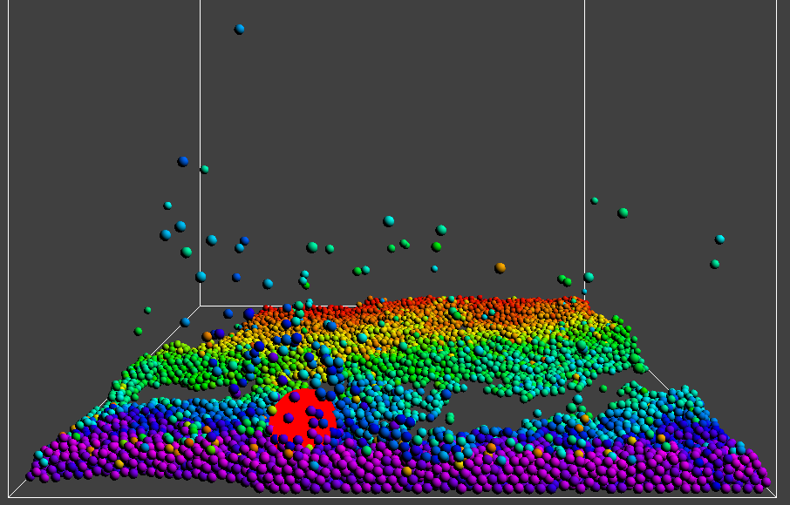
Implementation: Results – II
User haptic interaction

Slide 20
Results: Comparison
SPH in haptic rendering of dental filling materials [Brian ‘15]:
2,000 particles ~ 447fps
Dual GTX GPU: SPH calculation, graphical rendering
Six DoF haptic rendering with fluids and solids [Cirio ’11]
Restricted nbd* to 26 immediate particles {same as our box nbd*}
32,000 fluid particles ~ 70fps; rigid bodies doesn’t take much time to render
Quadro GPU: SPH calculation
Our work [ongoing]:
10,000 particles ~ 50fps, 32-bit API, other optimizations yet to apply
Both DEM calculation in box nbd* and graphical rendering in single GPU
*nbd = neighborhood

Slide 21
Future aspects: SPH and graphics
Work upgrade : fluid surface reconstruction : construct iso-surfaces
: 32-bit simulation {HAPI} : slow, recent CUDA not supported
: 64-bit support : OpenHaptics toolkit
DEM–SPH coupling : force interpolation from nbd using discussed kernels after DEM
Granular material : surface friction [Otaduy ‘11] : pressure but no attraction (adhesion)
: velocity damping : dissipates kinetic energy
Fluids : surface tension {SPH}
: adhesion {SPH} instead of collide attraction

Slide 22
Proposals: interactive haptic mixing
Unified particle modelling for various objects {different liquids, solids, granulars}
Interactive fluids mixing
Granular solids mixing with fluids
Pouring of fluid on a concave bowl held {haptic} by user
Deformable object interaction constraints:
bounded particle position
high adhesion
high velocity damping, and more to find out
Fluids | Solids | Granular flow
Different fluids: density (mass), pressure, adhesion (K_{a}), tension (γ), viscosity (µ) | Fixed relative position of particles, constant density Forces and torque act on CoM | pressure friction wall friction
M.Tech 1st Stage Electrical Engineering, IIT Bombay

Slide 23
Thank you

Slide 24
SPH: kernels
All kernels are discussed by Muller[2] and Brian [8]
Density and surface tension kernel
Pressure kernel
Viscosity kernel
Adhesion kernel

Slide 25
Building uniform grids

Slide 26
Simulation parameters
Grid size vs particle size choice and collider choice

Slide 27
V_{AB}
V_{AB}^{Tan}
V_{B}
V_{A}
V_{AB}^{Nor}
B, R_{B}
F_{a}
|P_{AB}|
F_{P}
A, R_{A}
P_{AB}
P_{A}
F_{sh}
P_{B}
O

Slide 28
Ci
P_{i}
P_{i}
Wall
F_{P}
P_{i}

Slide 29
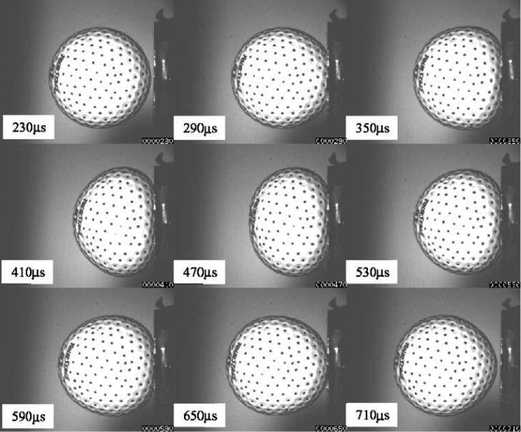
http://physics.stackexchange.com/users/9887/alfred-centauri
VIP Lab
EE, IIT Bombay

Slide 30
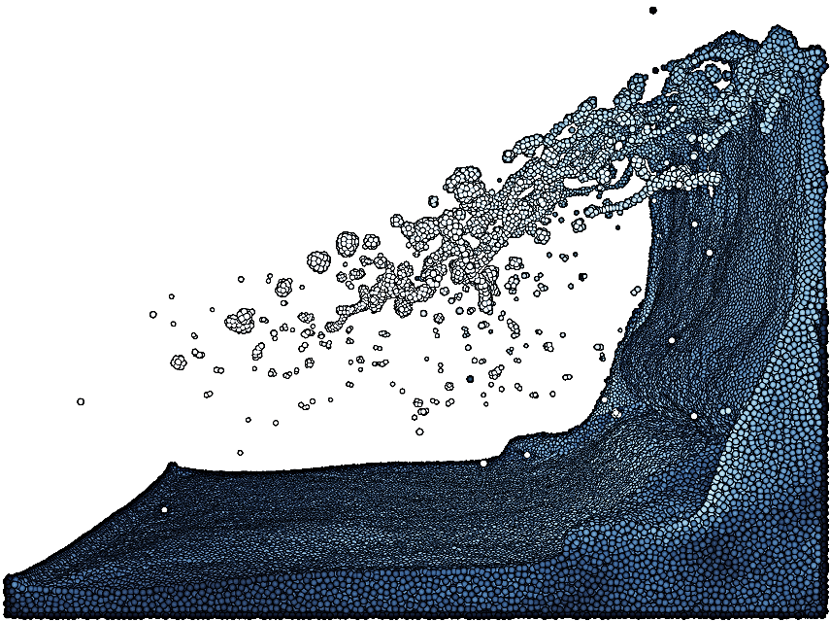
R. Winchenbach and et al, “Constrained Neighbor Lists for SPH-based Fluid Simulations“, ACM SIGGRAPH 2016

Slide 31
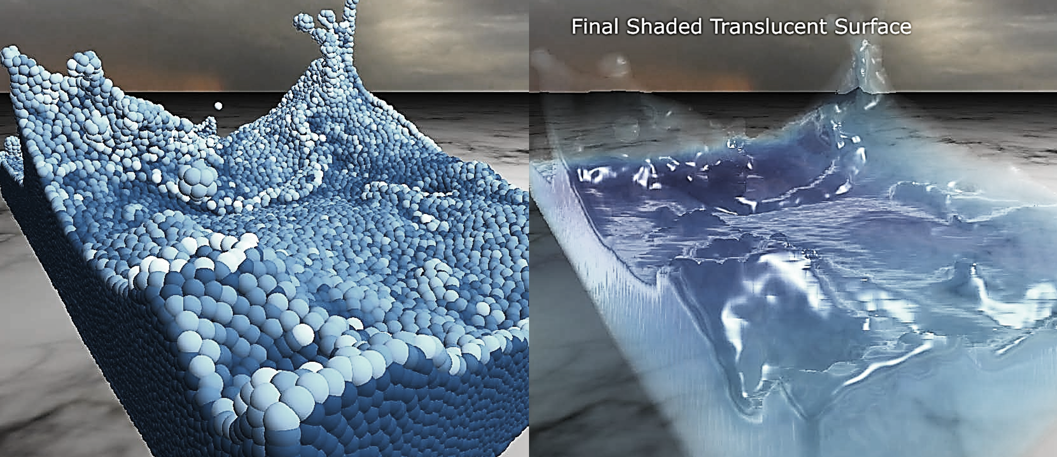

Slide 32
Collision Processing { accumulate force from neighbors, collider, walls }
Pressure (damped spring)
Shear (viscosity)
Integration { position ← velocity ← force }
Change in velocity ← accumulated force
Position ← simulation time step * velocity
Grid update { position and velocity are sorted according tor grid index }
Fast radix sorting
Improve memory access coherence
Attraction (after collision)
If proxy collision detected: non-zero collider forces sent to host for accumulation

Slide 33
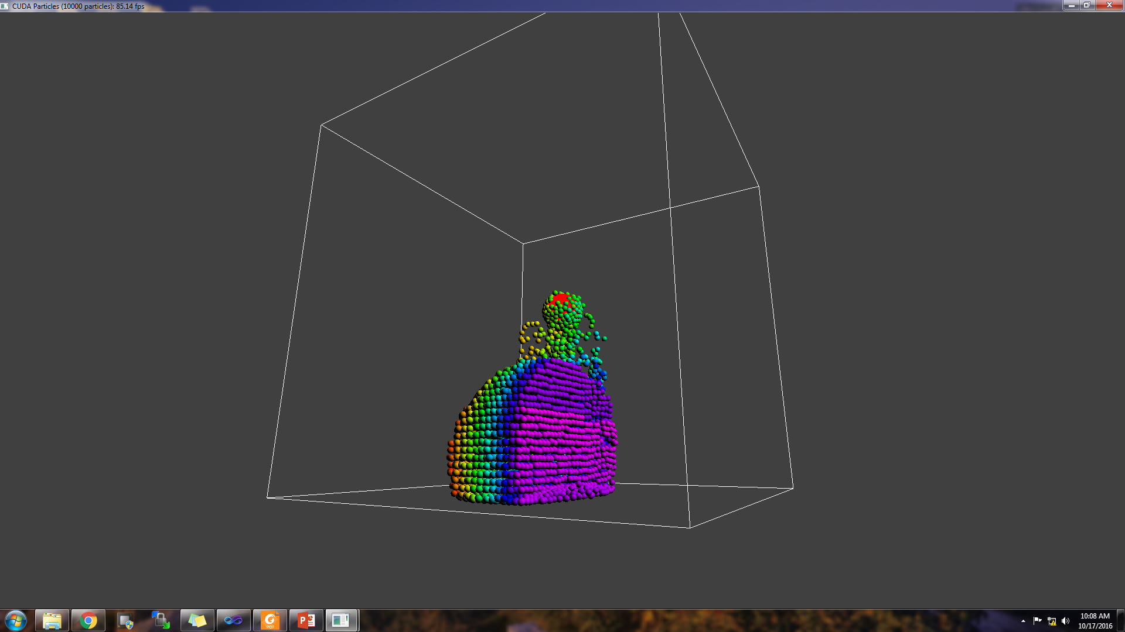

Slide 34
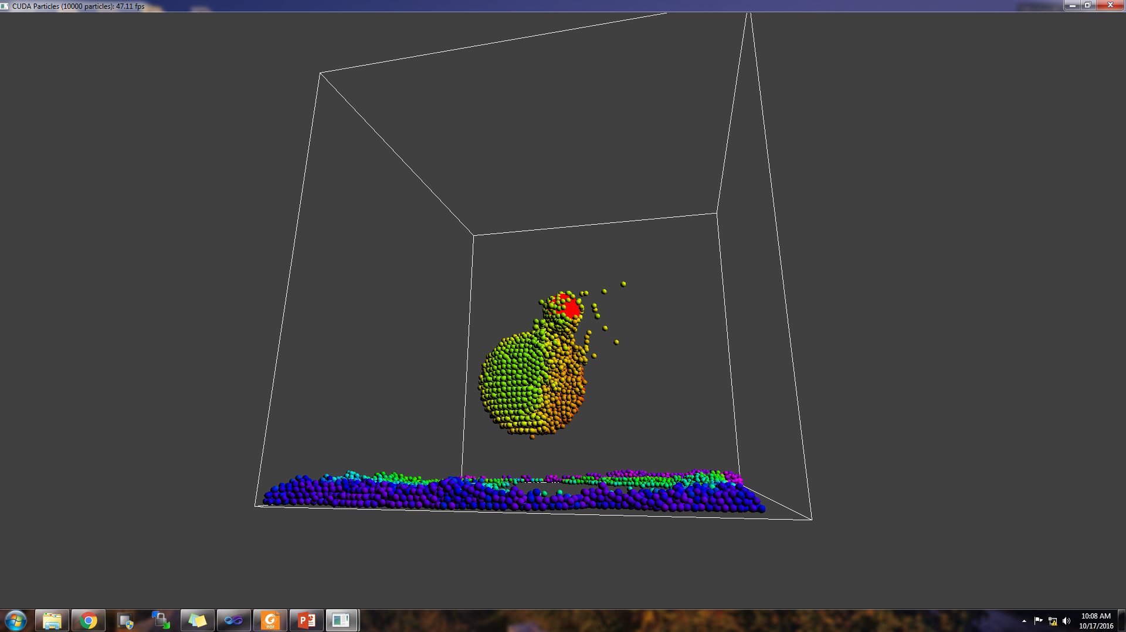

Slide 35
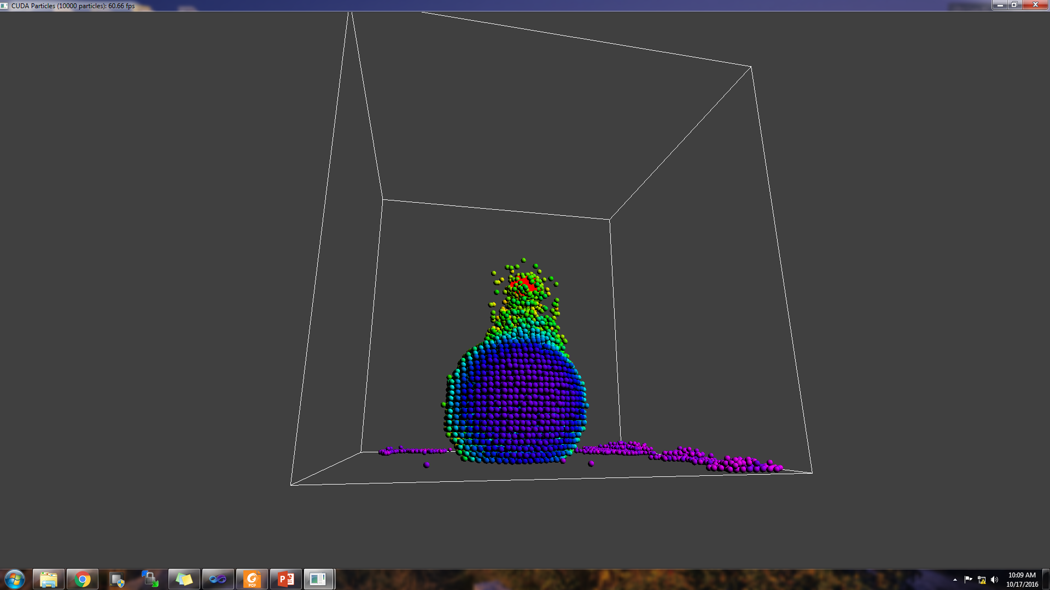

Slide 36
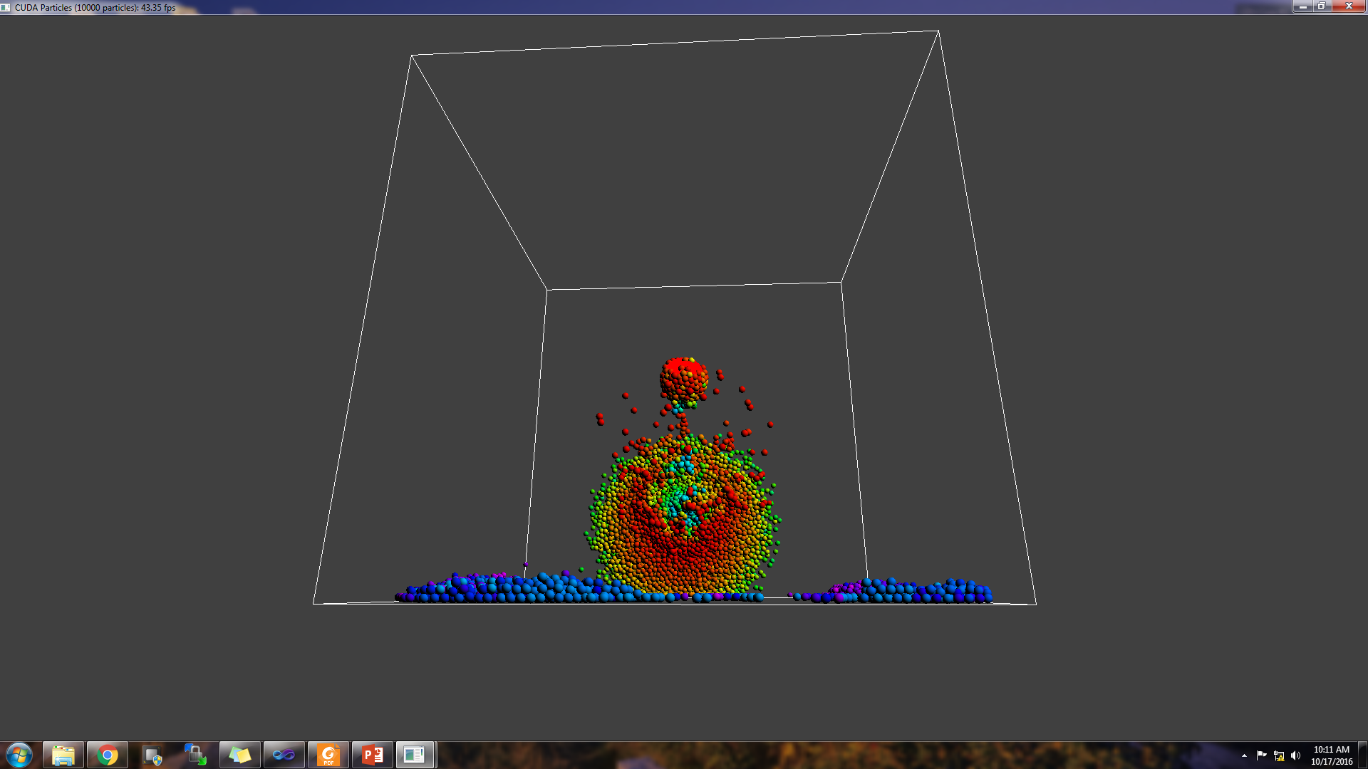

Slide 37
